Slide 1
Unit II Electro Analytical Techniques Topic: Conductometry Introduction
Dr. P. G. Umape
Pune Institute of Computer Technology

Slide 2
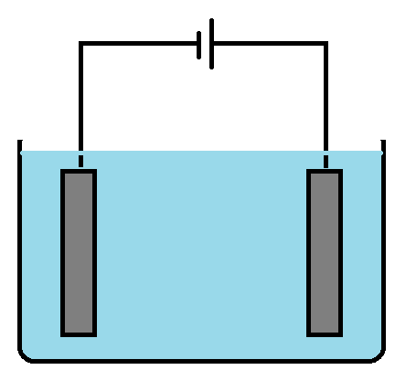
Introduction
What is electrolytic conductance?
The conductance offered by an electrolytic solution when a potential difference is applied between two electrodes i.e. anode and cathode
-
+
Here the cation migrates towards cathode while anion migrates towards anode.
The electrolytic conductance is not only responsible for charge migration but also transfer of mass. As these are the charged species of a matter.
+
-
+
-
-
+
+
-
-
-
+
+
Cathode
Anode

Slide 3
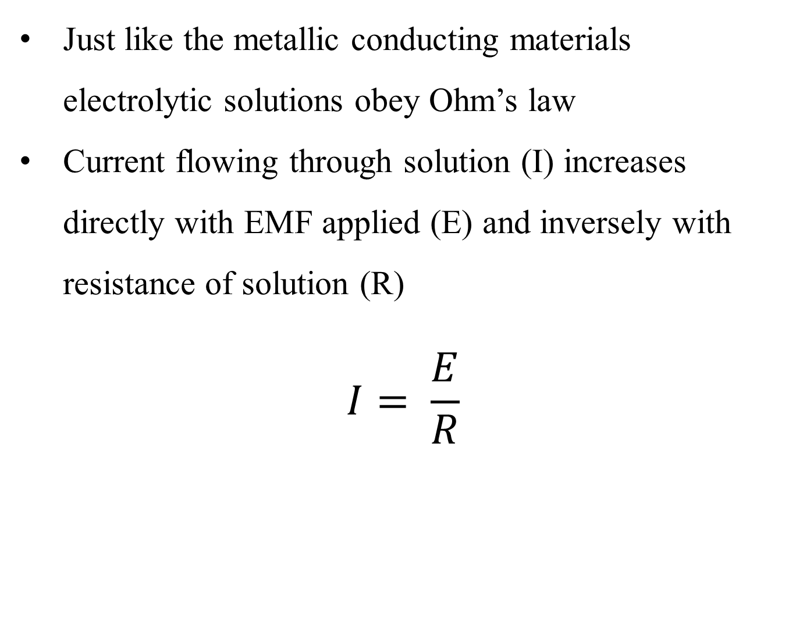
Introduction
Just like the metallic conducting materials electrolytic solutions obey Ohm’s law
Current flowing through solution (I) increases directly with EMF applied (E) and inversely with resistance of solution (R)
$$I= \frac{E}{R}$$
Here
E = voltage in volts
I = current in ampere
R = resistance in ohm

Slide 4
Introduction
Conductance (C): it is the ease with which the current flows through a conductor or a solution.
In electrochemistry conductance (C) is the most commonly used terminology instead of resistance.
It is reciprocal of resistance
As unit of resistance is ohm, unit of conductance is ohm⁻¹ or mho.

Slide 5
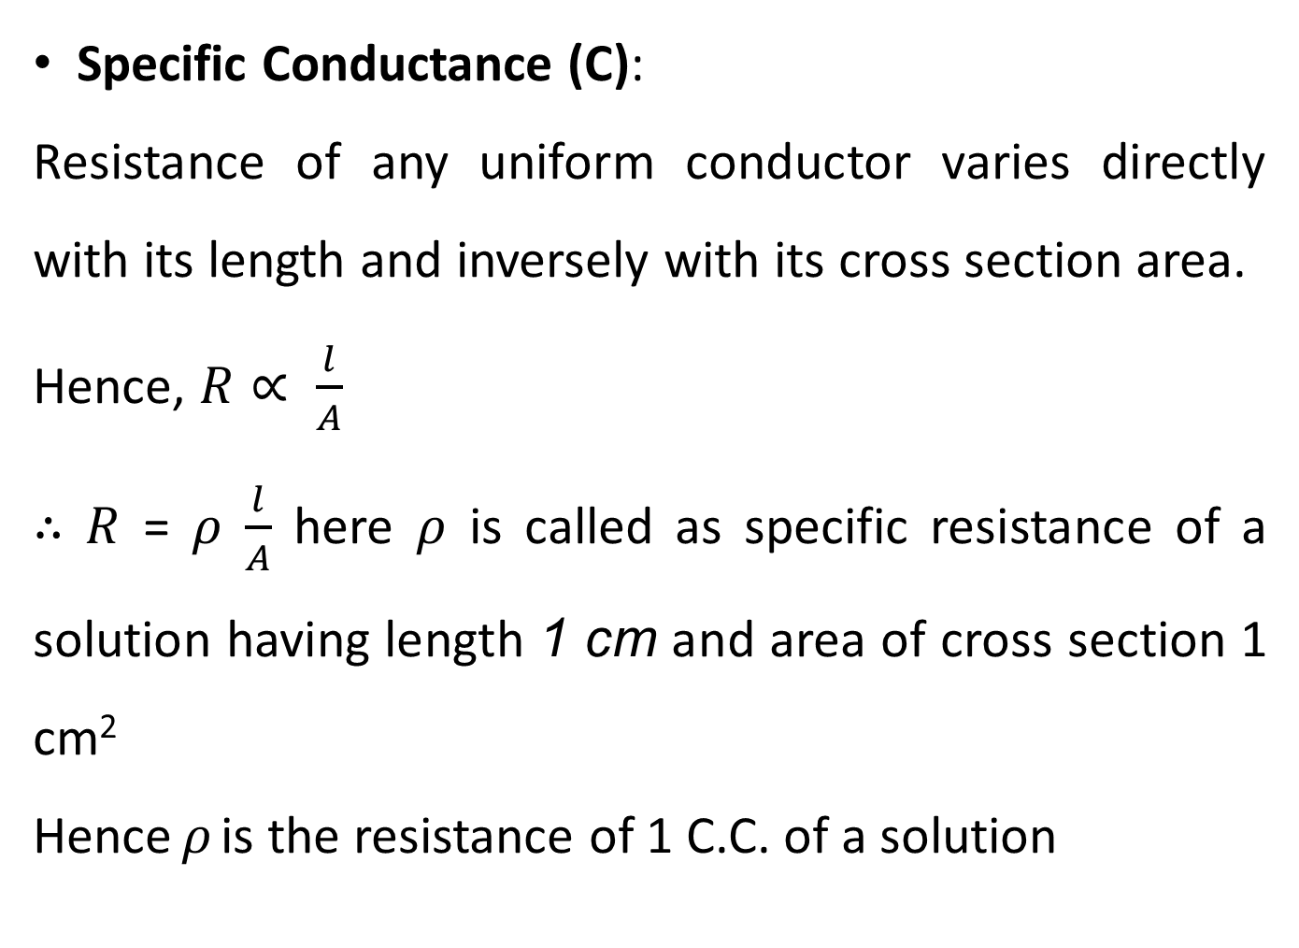
Introduction
Specific Conductance (C):
Resistance of any uniform conductor varies directly with its length and inversely with its cross section area.
Hence, $R∝ \frac{l}{A}$
$∴$ $R$ = $ρ$ $\frac{l}{A}$ here $ρ$ is called as specific resistance of a solution having length 1 cm and area of cross section 1 cm²
Hence $ρ$ is the resistance of 1 C.C. of a solution

Slide 6
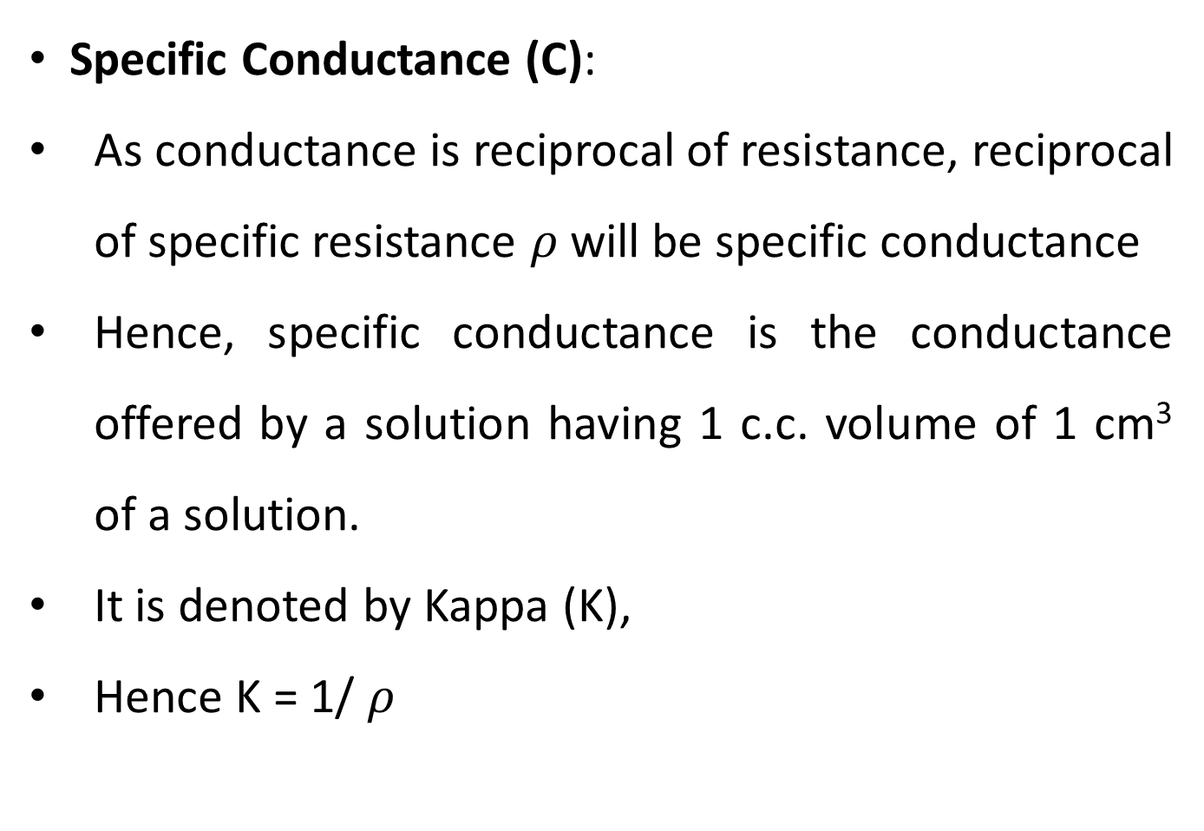
Introduction
Specific Conductance (C):
As conductance is reciprocal of resistance, reciprocal of specific resistance $ρ$will be specific conductance
Hence, specific conductance is the conductance offered by a solution having 1 c.c. volume of 1 cm³ of a solution.
It is denoted by Kappa (K),
Hence K = 1/ $ρ$

Slide 7
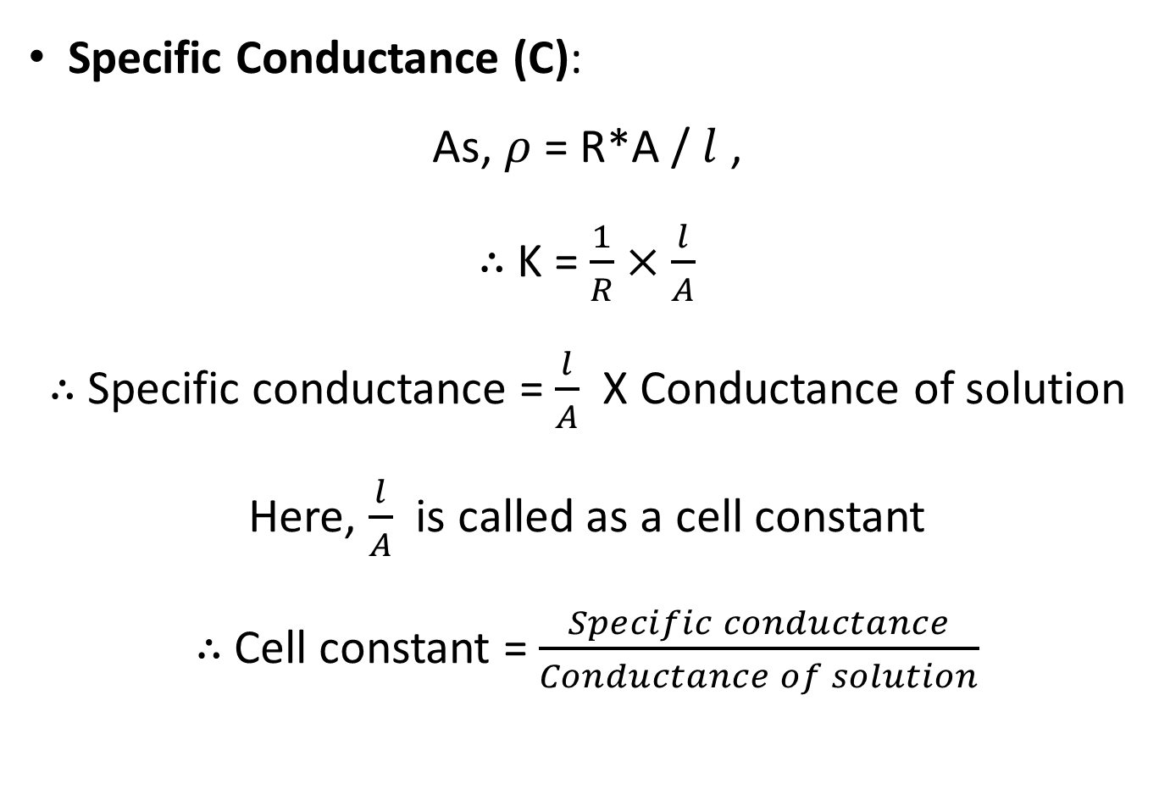
Introduction
Specific Conductance (C):
As, $ρ$ = R*A / $l$ ,
$∴$ K = $\frac{1}{R}×\frac{l}{A}$
$∴$ Specific conductance = $\frac{l}{A}$ X Conductance of solution
Here, $\frac{l}{A}$ is called as a cell constant
$∴$ Cell constant = $\frac{Specific conductance}{Conductance of solution}$

Slide 8
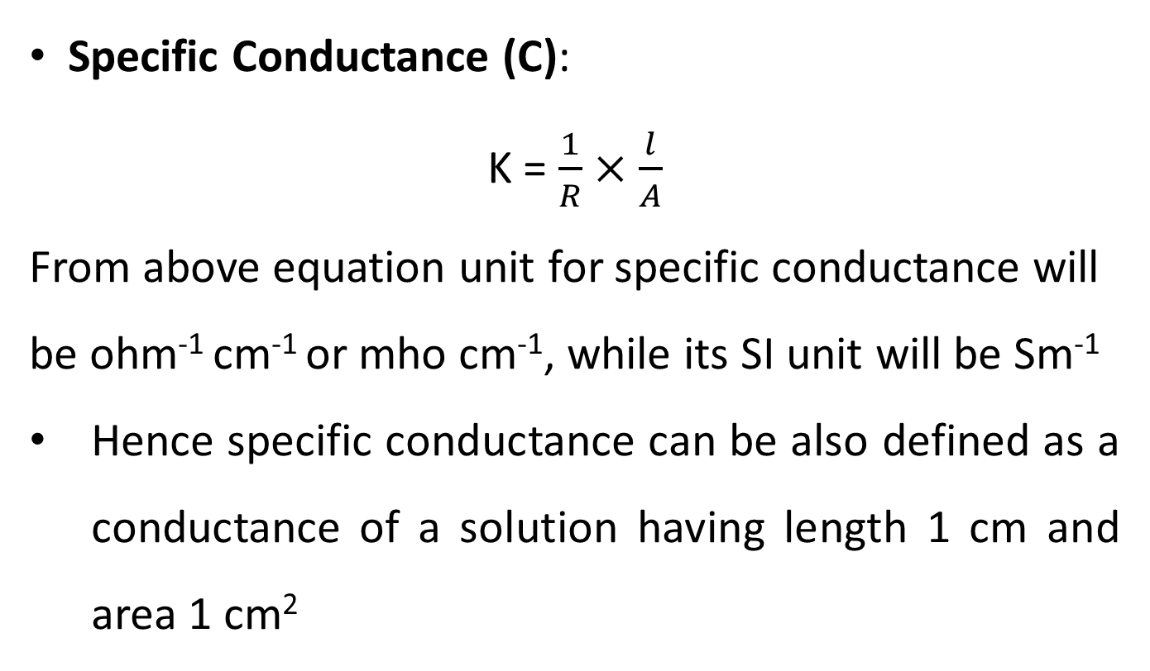
Introduction
Specific Conductance (C):
K = $\frac{1}{R}×\frac{l}{A}$
From above equation unit for specific conductance will be ohm⁻¹ cm⁻¹ or mho cm⁻¹, while its SI unit will be Sm⁻¹
Hence specific conductance can be also defined as a conductance of a solution having length 1 cm and area 1 cm²

Slide 9
Introduction
Equivalent Conductance (Ʌ):
While discussion of specific conductance volume of solution is considered (1 c.c.).
But in case of electrolytic conductance number of ions and charge on the ions plays very important part, hence equivalent conductance is of greater significance for discussion of electrolytic conductance
It deals with definite fundamental weight of electrolyte i.e. equivalent weight.

Slide 10
Introduction
Equivalent Conductance (Ʌ):
If one gram equivalent of an electrolyte is dissolved in V ml of a solvent, then the conductivity offered by all the ions produced from one gram equivalent of solute is known as equivalent conductance.
Equivalent conductance of a solution can be related to specific conductance by following equation
Ʌ = K * V
Here v is the volume of solution containing 1 gm-equivalent of electrolyte.

Slide 11
Introduction
Equivalent Conductance (Ʌ):
If C is the concentration of solution as gram equivalent per litre (normality) then
C (N) = n/V * 1000
There for V = n/C * 1000
For 1 gm-equivalent V = 1000/C
Hence Ʌ = K * 1000/C
From above equation unit of equivalent conductance will be ohm⁻¹ cm² per equivalent or mho cm² per equivalent

Slide 12
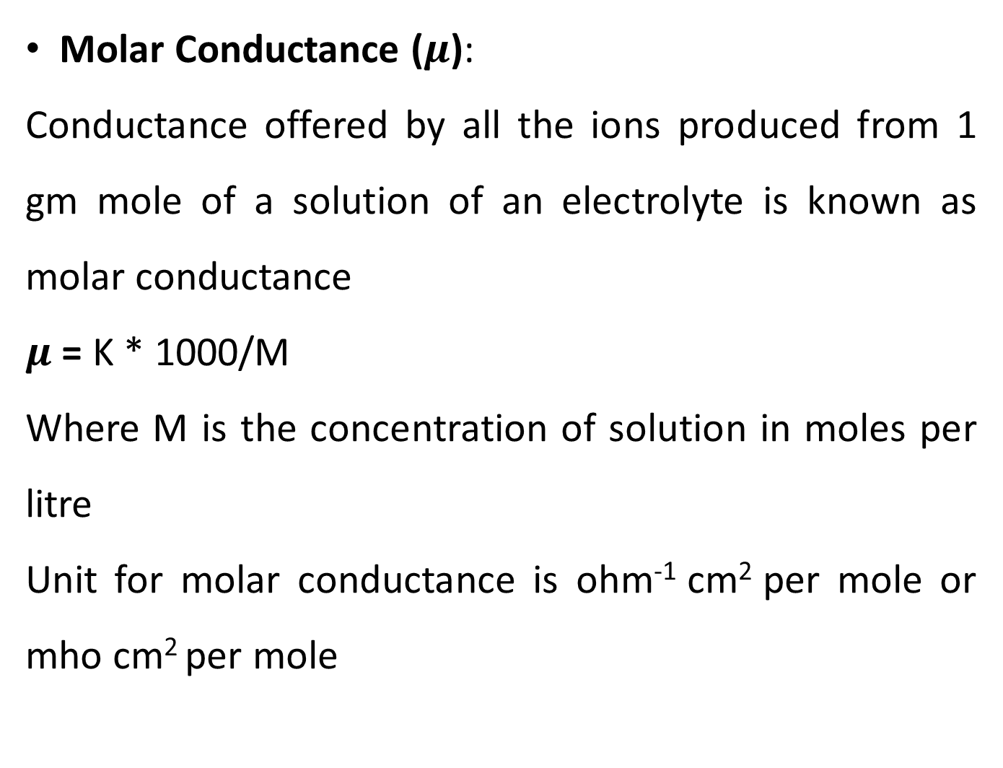
Introduction
Molar Conductance ($μ$):
Conductance offered by all the ions produced from 1 gm mole of a solution of an electrolyte is known as molar conductance
$μ$ = K * 1000/M
Where M is the concentration of solution in moles per litre
Unit for molar conductance is ohm⁻¹ cm² per mole or mho cm² per mole

Slide 13
Thank You

